Slide 1
Testing Review
Team 4

Slide 2

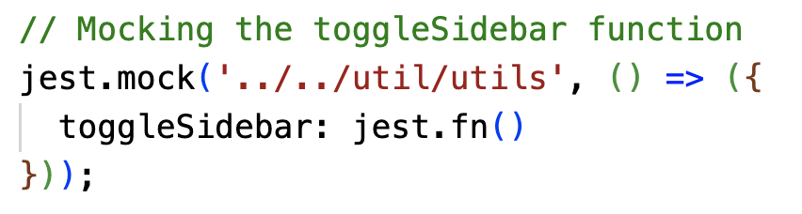
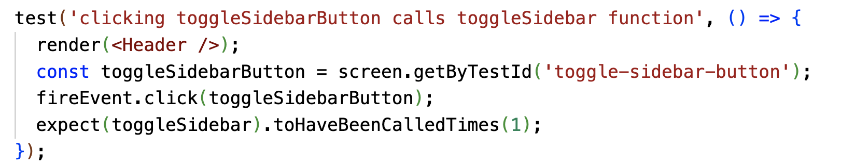
Frontend
Using Jest and React Testing Library
Use Given-When-Then format
Mocked Functions using Jest
Header.test.tsx

Slide 3

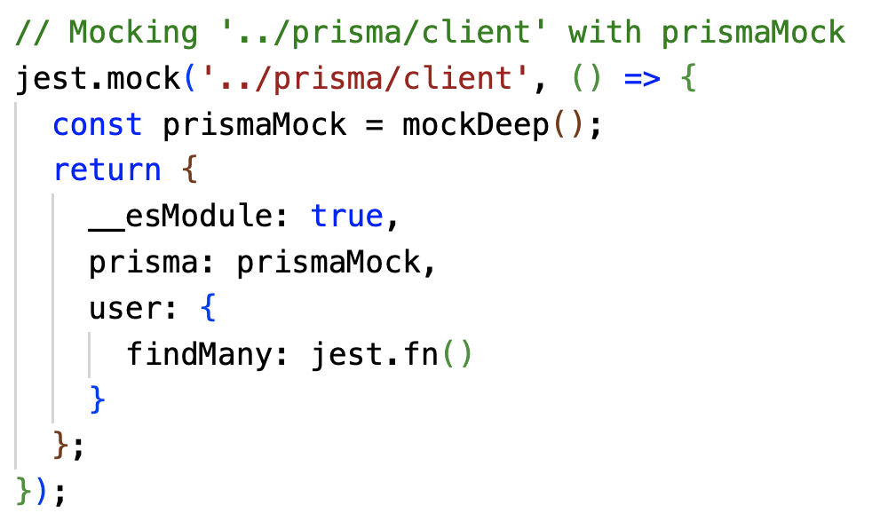
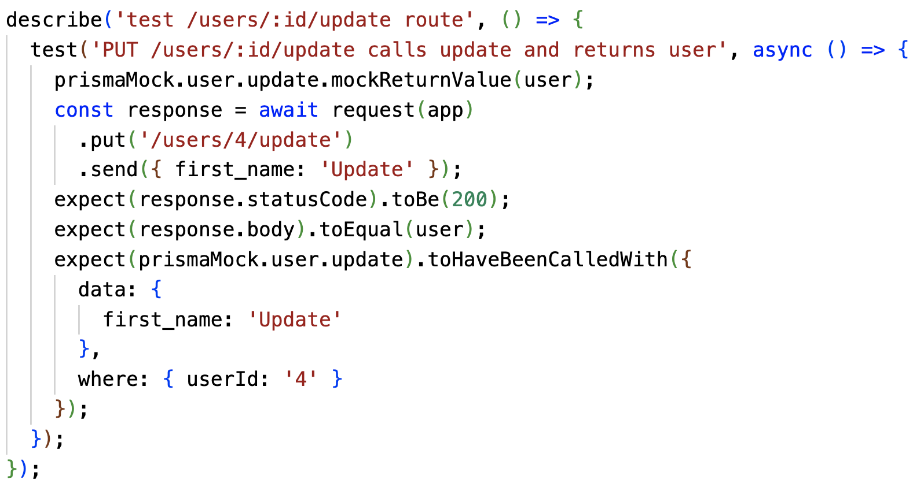
Backend
Using Jest with Supertest for HTTP requests
Many Testing Layers - API should be the most robust part of project
Happy Path/Sad Path
Mocked Prisma Client
Mocked Database Queries
Testing Environment Seeded Database
Integration Testing with HTTP requests originating from Web/Mobile

Slide 4
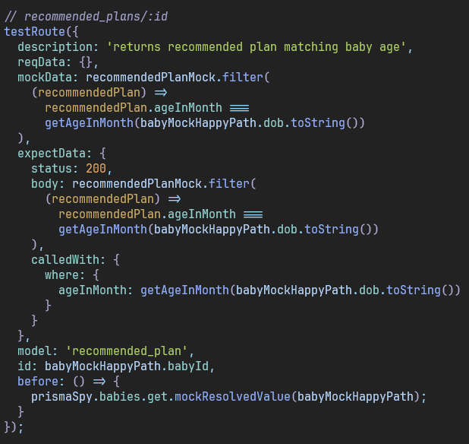
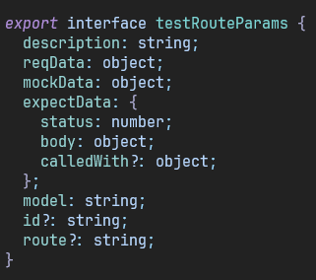
Backend - Factory

Slide 5


Integration Tests
Acceptance Tests
Use Jest to check if backend api and frontend works correctly with test database.
Using Cypress that mimics real user interactions with web application
Show app to client whenever new features are implemented and get feedback
Deploy TestFlight App once core components are implemented

Slide 6
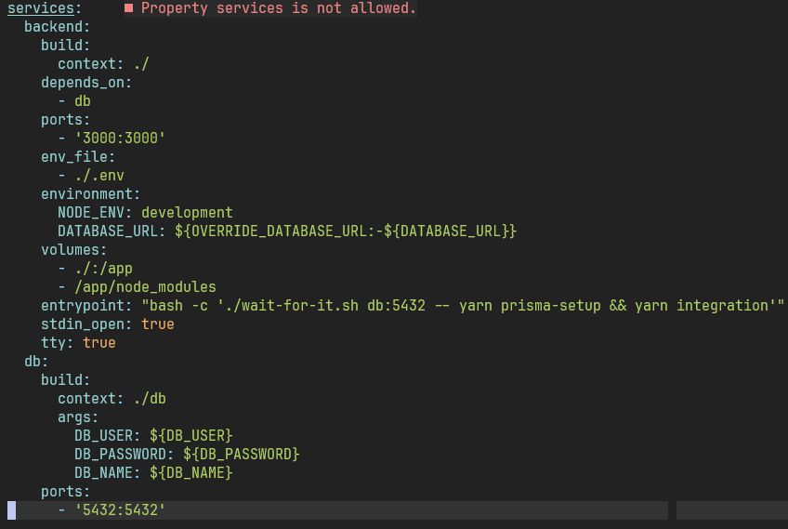
Docker Testing Environment

Slide 7
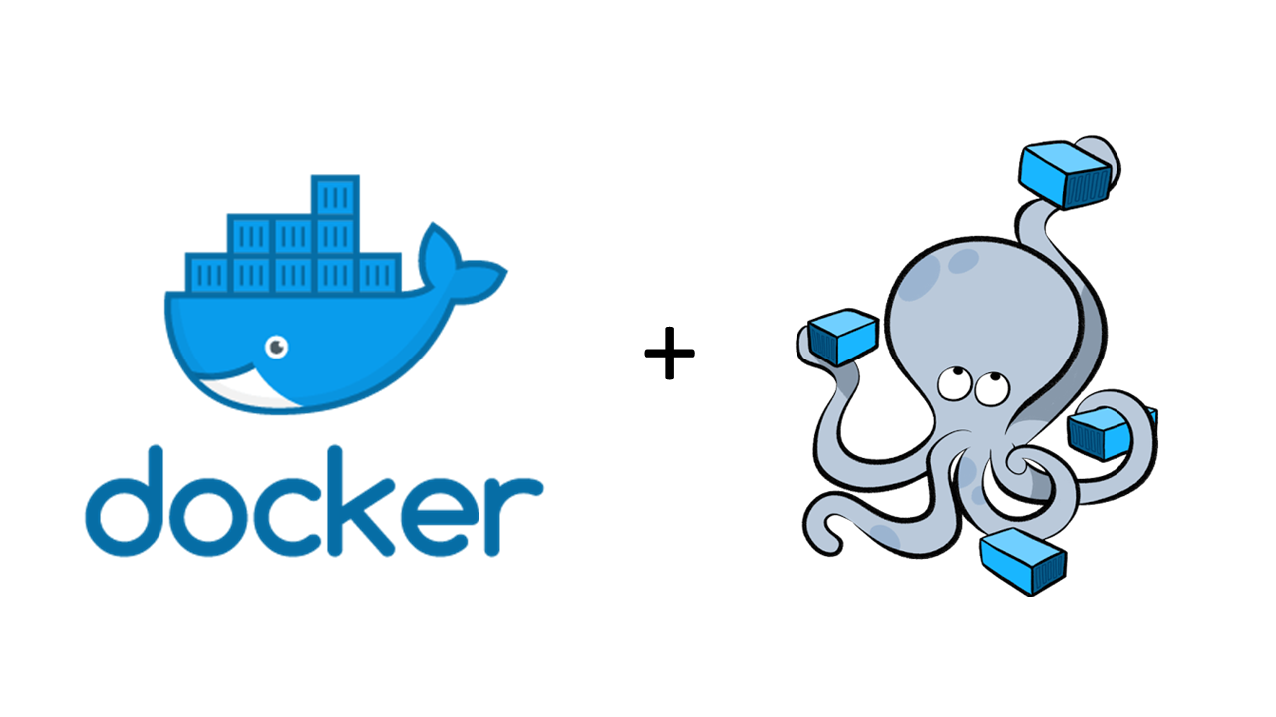
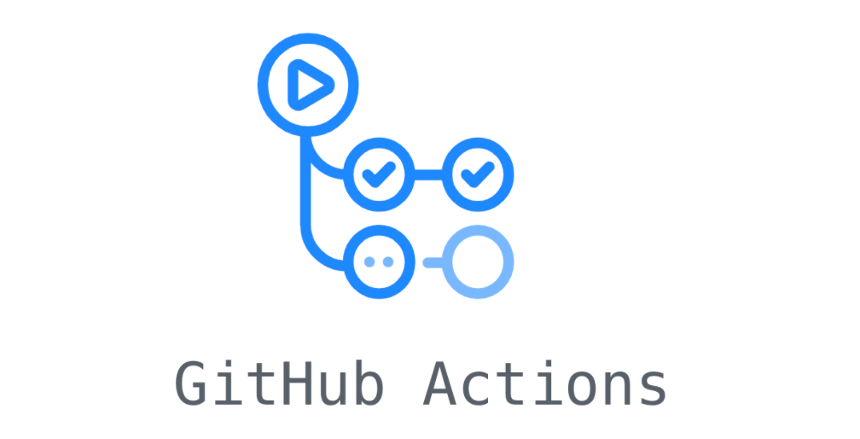
Regression Testing
Store history of test results to compare against and track bugs
Use Docker Containers/Compose to maintain identical environments
Run tests both locally and on GitHub hosted runners

Slide 8


Enforcing Tests
Pre-commits
ESLint enforces correct syntax and detects many common sources of bugs
PR Template
PR only merged when code coverage is more than 80%
Using Github Actions
Asks Requester whether they have completed tests, Reviewers will check test code and see automatically run test results
Notes:
Haruko

Slide 9
Questions/Feedback
Thank you!

